Slide 1


Computer Graphics
Lecture 13
Filling Area

Slide 2
Seed Fill Algorithm
Boundary-fill: Start from an interior point and paint outward from this point till the boundary is reached; called boundary- fill.
Flood-fill: Start from an interior point and start painting
outward from this point till the end of cluster.

Slide 3
Polygon Filling
Seed Fill:
Boundary Filling:
Edges of the polygon is drawn first. Take a seed pixel
(x,y) inside the polygon.
Find the neighboring pixels until boundary is reached
Seed (x,y)

Slide 4
Polygon Filling
Seed Fill:
Boundary Filling:
Edges of the polygon is drawn first. Take a seed pixel
(x,y) inside the polygon.
Find the neighboring pixels until boundary is reached.
Two types of searching a) 4-connected b) 8-connected
pixels
(x, y+1)
(x-1, y)
(x+1, y)
Seed (x,y)
(x, y-1)
4-Connected Pixels

Slide 5
Polygon Filling
Seed Fill:
Boundary Filling:
Edges of the polygon is drawn first. Take a seed pixel
(x,y) inside the polygon.
Find the neighboring pixels until boundary is reached.
Two types of searching a) 4-connected b) 8-connected
pixels
(x, y+1)
(x-1, y)
(x+1, y)
Seed (x,y)
(x, y-1)
8-Connected Pixels

Slide 6

Boundary Fill Algorithm
The following steps illustrate the
recursive boundary-fill algorithm:
idea of the
Start from an interior point.
If the current pixel is not already filled and if it is not an edge point, then set the pixel with the fill color, and store its neighboring pixels (4 or 8- connected) in the stack for processing. Store only neighboring pixel that is not already filled and is not an edge point.
Select the next pixel from the stack, and continue with step 2.

Slide 7

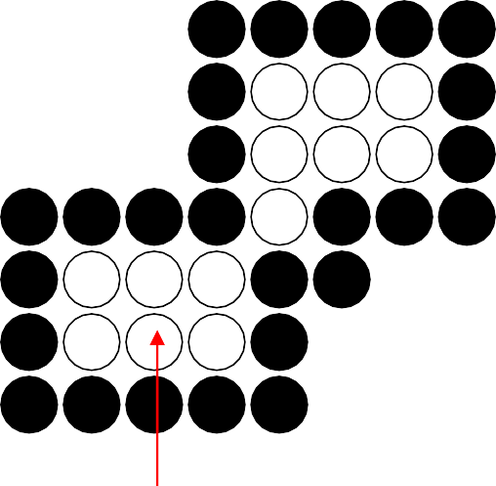
Boundary Fill Algorithm
4-connected (Example)
Start Position

Slide 8

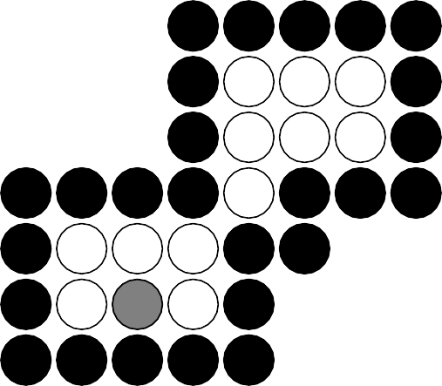
Boundary Fill Algorithm
4-connected (Example)
3
2
1
1
2
3

Slide 9
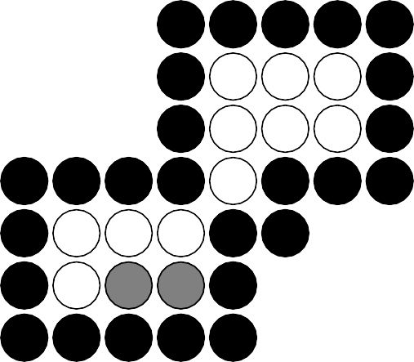
Boundary Fill Algorithm
4-connected (Example)
4
2
1
1 4
2

Slide 10
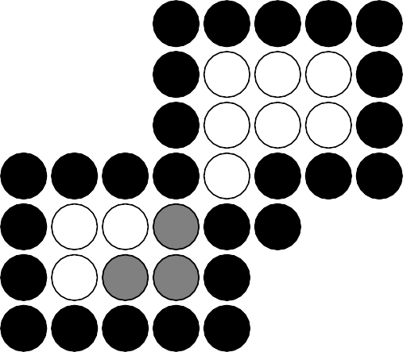
Boundary Fill Algorithm
4-connected (Example)
2
1
1
2

Slide 11

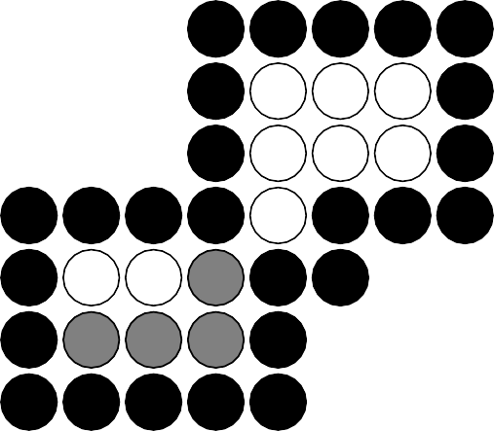
Boundary Fill Algorithm
4-connected (Example)
5
1
5 1

Slide 12
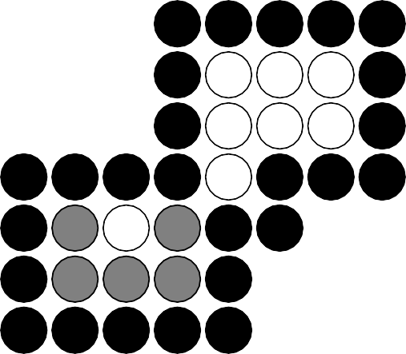
Boundary Fill Algorithm
4-connected (Example)
1
1

Slide 13
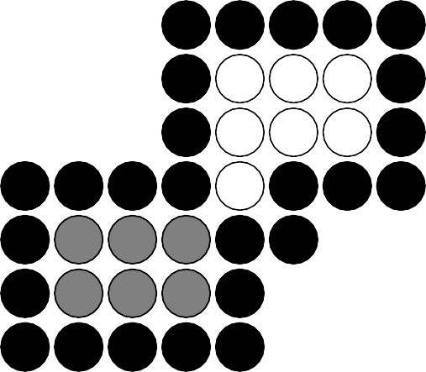
Boundary Fill Algorithm
4-connected (Example)

Slide 14
Boundary Fill Algorithm
8-connected (Example)
Start Position

Slide 15

Boundary Fill Algorithm
8-connected (Example)
5
4
3
2
1
4 1 5
2 3

Slide 16
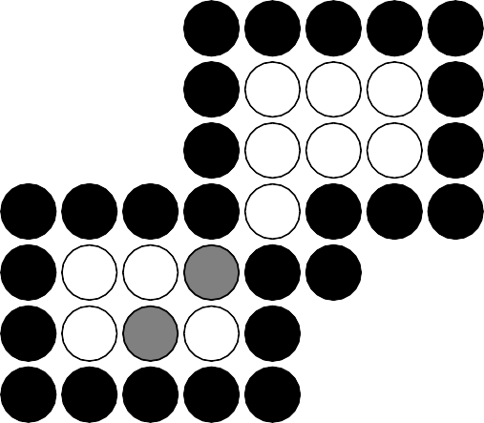
Boundary Fill Algorithm
8-connected (Example)
6
4
3
2
1
6
4 1
2
3

Slide 17
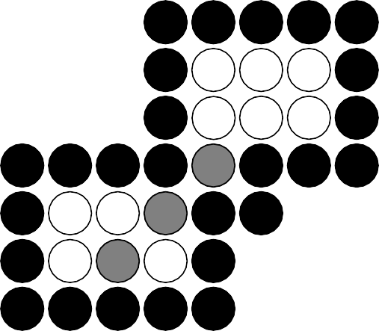
Boundary Fill Algorithm
8-connected (Example)
8
7
4
3
2
1
7
8
4 1
2
3

Slide 18

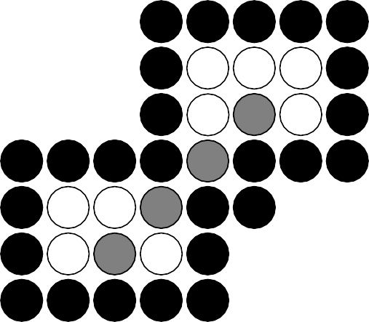
Boundary Fill Algorithm
8-connected (Example)
12
11
10
9
7
4
3
2
1
11 9 12
7 10
4 1
2
3

Slide 19
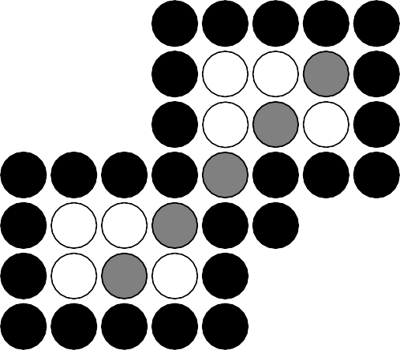
Boundary Fill Algorithm
8-connected (Example)
11
10
9
7
4
3
2
1
11 9
7
10
4 1
2
3

Slide 20
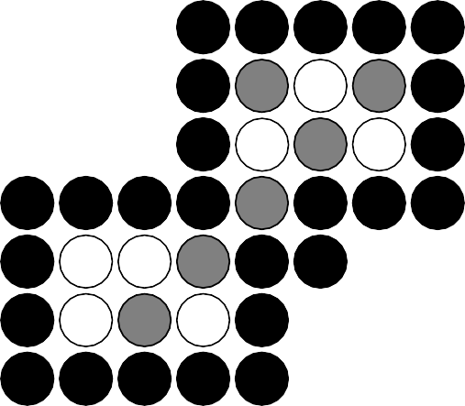
Boundary Fill Algorithm
8-connected (Example)
10
9
7
4
3
2
1
9
7
10
4 1
2
3

Slide 21
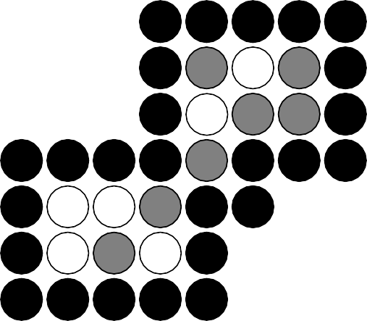
Boundary Fill Algorithm
8-connected (Example)
9
7
4
3
2
1
9
7
4 1
2
3

Slide 22

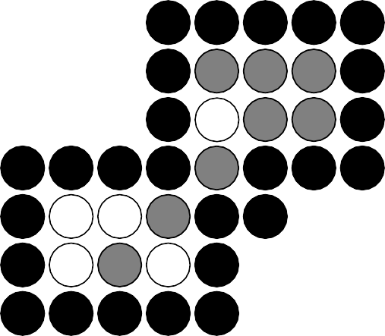
Boundary Fill Algorithm
8-connected (Example)
7
4
3
2
1
7
4 1
2
3

Slide 23
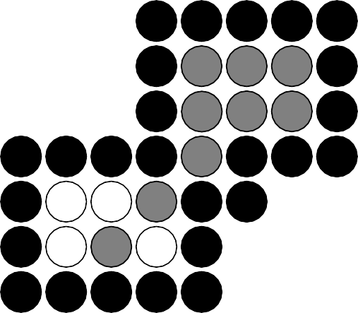
Boundary Fill Algorithm
8-connected (Example)
4
3
2
1
4 1
2
3

Slide 24

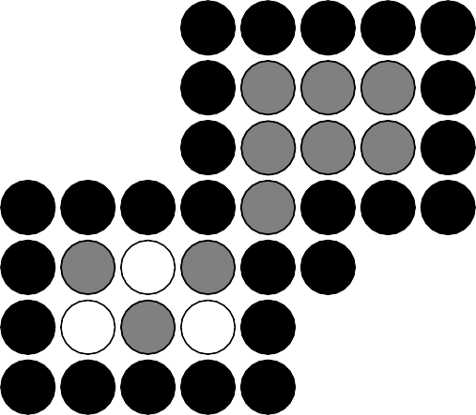
Boundary Fill Algorithm
8-connected (Example)
3
2
1
1
2
3

Slide 25
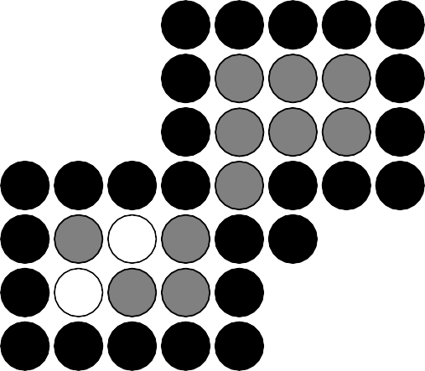
Boundary Fill Algorithm
8-connected (Example)
2
1
1
2

Slide 26

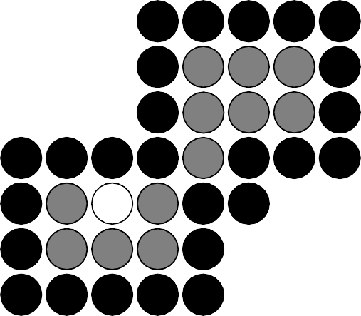
Boundary Fill Algorithm
8-connected (Example)
1
1

Slide 27
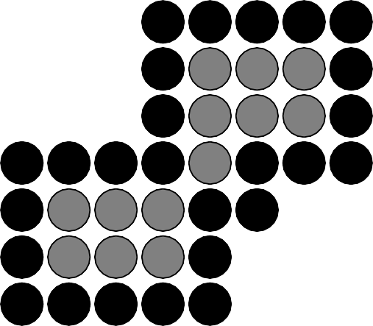
Boundary Fill Algorithm
8-connected (Example)

Slide 28
Boundary Fill Algorithm
Since the previous procedure requires considerable
stacking of neighboring pixels, more efficient
methods are generally employed.
These methods (Span Flood-Fill) fill horizontal
pixel spans across scan
lines,
or 8-connected
instead of
proceeding to 4-connected
neighboring pixels.
Then we need only stack a beginning position for each horizontal pixel spans, instead of stacking all
unprocessed neighboring positions around the current position.

Slide 29
Polygon Filling
Seed Fill:
– Flood Filling: starts from seed, old color replace by
new color. Here old color is black and new color is yellow
border color is while

Slide 30
The End

